Slide 1
DS 6371: Statistical Foundations for Data Science
Drawing Statistical Conclusions

Slide 2
INTRODUCTIONS Feel free to post a short bio on the week 1 discussion board

Slide 3
DS 6371: Summer 2019
Instructor: Jacquie Cheun
Jcheun@mail.smu.edu
Office hours will be by email- Set-up Time with me.
Teaching Assistant/Grader:
Office Hours (shared by all sections of 6371): To be determined…I’ll let you know!
*All times, here and throughout the course,
should be assumed to be in Central Standard Time

Slide 4
E-mails
You are welcome to email the TA and/or myself with any questions you have.
Please ask the TA about any homework questions (content, late assignments, etc.). Please cc me on those emails.
Always include your section (406) or the day and time your section meets even if you don’t think it matters.
If we need to look up anything about your assignments or grades, we need to know which section you’re in to get that information.
Some due dates are different for different classes.

Slide 5
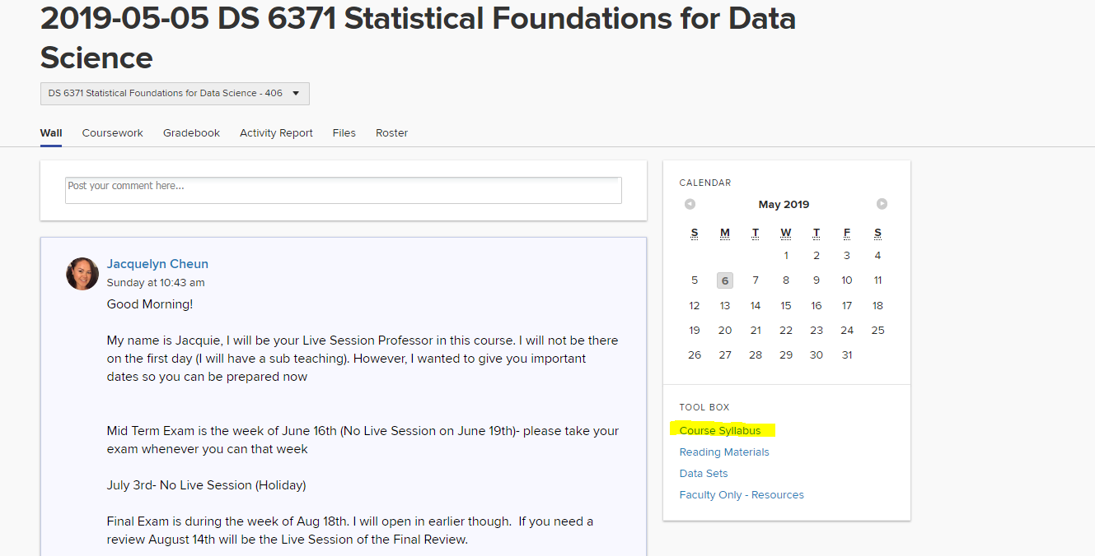
Read the Syllabus
Read the syllabus, word for word. Do not merely glance over it.
- There is very important information in there
We will only mention some of the important points today in class.

Slide 6
Important Dates
May 22
Week 3 Survey Due
June 12
Week 6 Survey Due
June 19
Midterm Exam – No Live Session
July 3
No Live Session Holiday / Week 9 Survey Due
Aug 14
Review for Cumulative Final (Live Session)
Aug 22
Final exam

Slide 7
Grade Breakdown
Homework (11%): Homework will be assigned most weeks. Our Homeworks will be due the Sunday following Live Session at 11:59PM Central. It can be turned in up to 1 day late (Monday at 11:59PM), for any reason, however, late homework will be penalized at a rate of 10 points.
All Homework assignments will be weighted the same.
Your lowest homework (by percent) will be dropped at the end of the term. This is in lieu of extended deadlines (more than one day) for various life events that come up.
All data sets for cases studies and exercises should be available on the 2ds website. Datasets for problems assigned out of the book can be found at the text book website: www.statisticalsleuth.com.
The link to SAS on Demand for this course is https://odamid.oda.sas.com/SASODAControlCenter/enroll.html?enroll=5f1daeec-a5d2-4f99-9ad8-3fd9ee885879. Several data resources will be available for you to use. Keep in mind that they are updated week to week, and the data for future weeks may not be validated.

Slide 8
Grade Breakdown
Homework cont’d.
Be sure to put your name at the top of every page in the document
It is a good idea to include your code and always include any output (tables & plots) you refer to
You should not include a printout of the data or the “datalines” part of the code.
You should not include tables and plots that you don’t refer to in your answer (or even code that you don’t use)
No SAS DUMP!
Project (6%): Collaborative project in lieu of homework for weeks 13 and 14

Slide 9
Grade Breakdown
Quizzes (13%): Each week there will be a short, online quiz over the videos and readings. Answers to the quizzes can be found directly in the videos and/or readings. Quizzes are due at 11:59PM CST the night BEFORE your Live Session. This allows time for the live session professor to review quiz answers and tailor the class to address any difficulties with that week’s material.
Quizzes cannot be completed late.
All Quizzes will be weighted the same.
You will earn FULL credit if you complete the quiz; regardless of your score, you will earn full credit if you complete it. Your lowest Quiz score will be dropped at the end of the term. This is in lieu of extended deadlines for various life events that come up.

Slide 10
Grade Breakdown
Participation and BLTs (20%): This component has three parts: viewing of asynchronous material, participation during live sessions, and participation on discussion boards and BLTs. The course is structured with both synchronous and asynchronous sessions. In order to participate fully in the synchronous sessions, you must complete ALL of the material for the asynchronous sessions each week.
Participation includes attending every Live Session from start to finish (the scheduled hour and a half.) This includes not using Video Pause excessively. You may miss 1 live session without penalty.
BLTs (Bi-directional Learning Tool) are questions asked during the asynchronous videos that require an answer before going on to the next part of the video. Some of these BLTs will be graded and some will not; however, completion of all of the BLTs is required. Everyone can see each other’s answers. This is a good place to discuss solutions with each other.
While you may be prompted to post in the discussion board (such as a short bio), it is not required unless the instructor specifically mentions it in class or on the wall in 2ds.

Slide 11
Grade Breakdown
Midterm Exam (25%): There will be a midterm exam at week 7 of the course. It will cover concept and hand-calculation questions as well as a data analysis question(s). The exam will be held online on Saturday, June 22nd, 2019 from 11am to 2pm Central.
We will have a review for the midterm during the Unit 7 Live Session.
Final Exam (25%): A final exam will be given the last week of the course. It will be comprehensive, containing concept and hand-calculation questions, as well as a data analysis question(s). It is a cumulative exam and is similar in format to the midterm. This test will be from 11am to 2pm Central on Saturday, August 17th, 2019.
We will have a review for the final during the Unit 15 Live Session.

Slide 12
Grade Breakdown
Exams continued.
Put your name on every page of the document, if applicable.
Exams are open book and open note.
Exams are strictly individual.
Any collaboration on the exam or discussion of course material during the time an exam is available is considered cheating.
If you cannot make the scheduled time for the midterm or final, please email me as soon as possible!

Slide 13
Grading Policy
Graduate Student Grading Policy: Graduate Students must receive a C or better in a course in order to pass the course. If a student must retake a course, then the second grade and the first grade are averaged for the purposes of the overall GPA. Failure to maintain a GPA of 3.0 or better will result in dismissal from the program.
Incompletes will only be given in the case of extraordinary circumstances that prevent you from finishing the semester. You must have completed at least 50% of the course with a passing grade to be eligible for an incomplete.
If a situation arises that may/will prevent you from completing the semester, email me as soon as possible so we can discuss options!

Slide 14
Course Schedule
Weekly (in this order)
Asynchronous Coursework
Quiz
Live Session
Homework

Slide 15
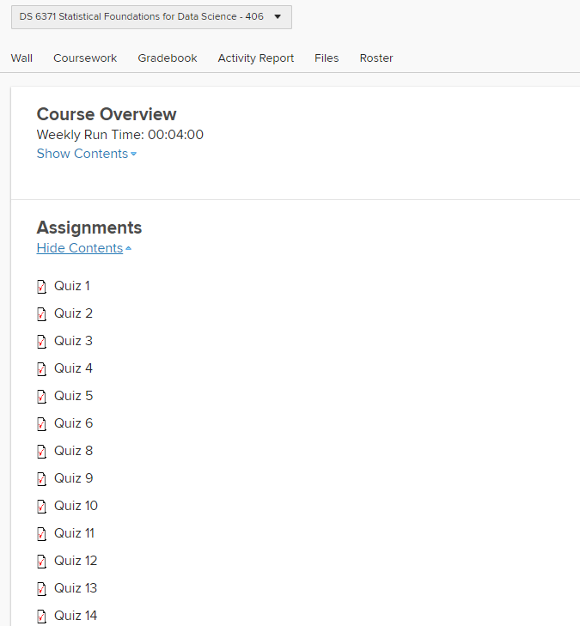
Weekly Schedule
Before the Live Session
Watch all videos, complete all BLTs
Complete and submit the Quiz by 11:59PM (CST) the night before the Live Session
Quizzes are open book and open note but should not be discussed with classmates until you have both completed and submitted the quiz.
Some of the quizzes may mistakenly say that there is a time limit, but all have unlimited time and just need to be turned in before the deadline.
Some may mistakenly say they are due at 8PM, but they are all due at 11:59PM.
All Quizzes and Exams are under Assignments in 2U

Slide 16
Weekly Schedule
After the Live Session
Complete and submit the Post-Live Session Homework
Due at 11:59PM (CST) the Sunday after the corresponding Live Session
For example, Homework 1 is due 11:59PM Sunday, Nov. 11, 2018.
If you already turned in Homework 1, but want to make some changes and resubmit it, email the TA (and cc me).
You can talk with other students about these assignments.
You can discuss ideas and help each other with code (though you should never send another student an entire assignment worth of code), but the write up must be your own.

Slide 18
Getting Help with Course Material
First: try to find the answer on your own through the book, google searches, etc. The internet has a wealth of information from SAS and R experts.
Second: ask your classmates. Ask a specific student or post on the weekly discussion board or on the wall.
Third: attend office hours if possible.
Fourth: email the TA and myself for help. It is best to email both of us (on one email) as we may be available to respond at different times, although specific homework questions should go to the TA.

Slide 19
Getting Help with 2DS
Contact Student Support:
studentsupport@datascience.smu.edu
(844) 768-5637
Examples:
Can’t view asynchronous content
Quiz or Homework won’t submit
Homework submitted but without attachment
Email the TA and cc me as well if this happens!
Can’t view Live Session recording

Slide 20
Honor Code

Slide 21
Honor Code
When you signed your letter of intent to enroll in the program, you initialed the following statement:
“I have read and agree to abide by the SMU Honor Code available online at: http://www.smu.edu/StudentAffairs/StudentLife/StudentHandbook/HonorCode”
Please know that the Honor Code is taken very seriously.

Slide 22
Honor Code Violations*
Academic Sabotage
Cheating
Fabrication
Facilitating academic dishonesty
Plagiarism
Copying solutions from prior semesters or from prior students
*http://www.smu.edu/StudentAffairs/StudentLife/StudentHandbook/HonorCode

Slide 23
Collaborative Work
Data science is a collaborative subject.
Most professors encourage collaborative work except when explicitly prohibited (usually on quizzes & exams).
Collaboration means helping one other, not copying answers from one another.
At a minimum, students who turn in exactly the same answers to the same homework will share the grade assigned.
If two students have the same answers, and the grade on the assignment is a 90, then each student will receive a 45.

Slide 24
Collaborative Work
Okay
Not okay
Discussing problems (or even solutions) with other students
Telling another student how you did something in SAS/R (which PROC/function and how to use it, etc.) or sending “snippets” of code (i.e. an example of how to use a PROC) to help them out on HW or projects.
Sending your answers to a student or receiving them from another student
Sharing anything, including ideas, when expressly forbidden, such as on exams
Passing off anyone else’s work or explanations as your own

Slide 25
Plagiarism
Here is an example of plagiarism:
A regression is a statistical analysis assessing the association between two variables. It is used to find the relationship between two variables.
The following is NOT plagiarism:
“A regression is a statistical analysis assessing the association between two variables. It is used to find the relationship between two variables.” (https://www.easycalculation.com/statistics/learn-regression.php).
The difference is in the punctuation and the attribution.
Note that one can self-plagiarize. If you are using something that you wrote (e.g. a blog or a previously published article), please reference yourself.

Slide 26
Consequences
Plagiarism, sabotage, fabrication, and cheating carry high penalties.
Instructors may choose to fail the student on the assignment, give a 0 for the assignment, fail the student for the course, and/or bring the student before the Honor Council.

Slide 27
Other
Create a running PP file that contains all of the live session PPs
Create a running word or txt file that keeps all of your SAS / R Code together in spot. Annotate this code as well!
You will want these running files so you can have ready access to what you need when you take the exams.

